Slide 1

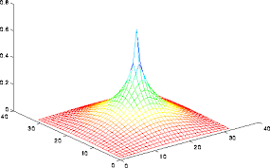
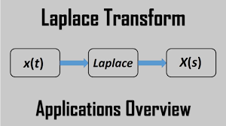
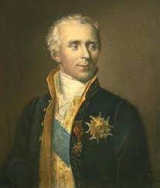
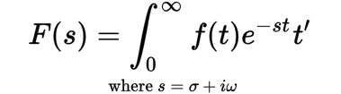
BVRIT HYDERABAD COLLEGE OF ENGINEERING FOR WOMEN
MATH POSTER - LAPLACE TRANSFORMATION: Background
Anusha V Kumar (416), Yalamanchili Gunavardhini (421), Rukmini Chakravarthula (406), Gaddam Sanjana (409) - ECE-A
SOME REAL TIME APPLICATIONS IN LAPLACE TRANSFORMS ARE:
-The Laplace transform is named after mathematician and astronomer Pierre-Simon, marquis de Laplace, who used a similar transform in his work on probability theory.
-Laplace is famously associated with the concept of "Laplace's demon." In a philosophical thought experiment, Laplace proposed that if a hypothetical entity knew the exact position and momentum of every particle in the universe, it could predict the future and determine the past with certainty, implying a deterministic universe. This idea sparked debates on determinism and free will.
Data mining/machine learning: The Laplace equation aids in predicting and analyzing knowledge in databases, benefiting data mining and machine learning applications.
Signal processing: The Laplace transform, a subset of the Fourier transform, simplifies data signal processing during transmission, enabling tasks like filtering and modulation.
Control systems: The Laplace transform converts system equations into algebraic form, allowing engineers to describe and analyze control systems using block diagrams.
Integrated circuit: Laplace transformations analyze circuits, aiding in the design and fabrication of integrated circuits (ICs) for electronic systems.
Probability: The Laplace transform helps assess voltage variations caused by charging currents, essential for probability analysis.
Analysis of electronic circuits: The Laplace transform efficiently solves differential equations in electronic circuit analysis.
System modeling: The Laplace transform simplifies calculations in modeling interconnected systems with multiple differential equations.
Digital signal processing: The Laplace transform is crucial in solving problems and achieving accurate results in digital signal processing.
Nuclear Physics: The Laplace transform is employed to accurately represent radioactive decay and explore analytic aspects of nuclear physics.
Process Control: The Laplace transform aids in analyzing variables for effective process control and achieving desired outcomes.
- Laplace's mathematical abilities were recognized early on, and at the age of 18, he published his first paper on differential equations. He gained recognition for his work on celestial mechanics and the study of planetary motion.
IN A BITE: 🍪
The Laplace transform converts a function of time into a function of complex frequency.
It simplifies the analysis of differential equations, transforming them from the time domain to the frequency domain.
The transformed function is represented by an algebraic equation in the complex plane.
It provides insights into the system's frequency response and stability.
Laplace transformation is used in control systems, circuit analysis, and signal processing.
It helps determine if a system is time-invariant.
The inverse transform can be applied to obtain the original function in the time domain.

